Slide 1
Movie Recommender System
Presented by
Farjana Akter Jui(1607004)
Sayma Sultana(1607025)

Slide 2
Machine learning
It is learning from examples and experience.
“A field of CS, gives computers the ability to learn without being explicitly programmed.” – Arthur Samuel (1959)

Slide 3
Machine learning
A type of AI that allows applications to become more accurate in predicting outcomes.
Basic premise is to build algorithms that can receive input data and use statistical to predict an output value(in acceptable range).
Machine Learning uses deep learning to arrive at the results.

Slide 4
Recommender System
Recommender systems are an important class of machine learning algorithms that offer "relevant" suggestions to users.
Based on past behaviour, relations to other users, item similarity, context...
Recommender systems are utilized in a variety of areas, and are most commonly recognized as playlist generators for video and music services.

Slide 5
Recommender System
Categorized as either collaborative filtering or a content-based system.
Recommender systems have been developed to explore research articles and experts, collaborators, financial services, and life insurance.

Slide 6
Approaches To Recommendation
Popular-based: Recommend based on item which are in trend right now.
Content-based: Recommend based on item features.

Slide 7
Approaches To Recommendation
Collaborative Filtering: Recommend items only on the users past behavior.
User-based: Find similar users to me and recommend what they likes.
Item-based: Find similar items to those that i have previously liked.

Slide 8
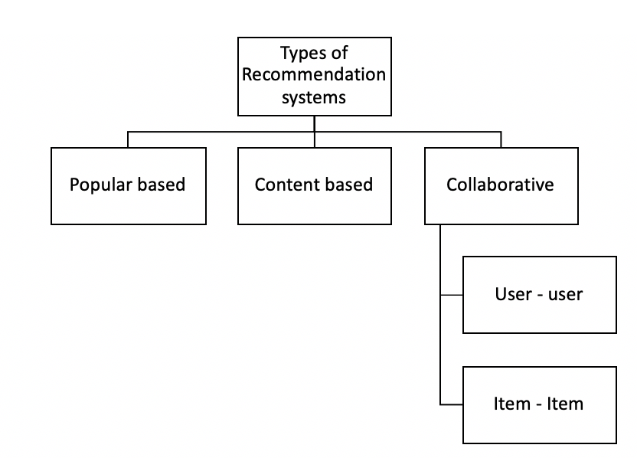
Approaches To Recommendation

Slide 9
Process For Movie Recommender system

Slide 10
Dataset Usage
Here MovieLens Dataset have been used.
The data set consists of:
100,837 ratings (1-5) from 610 users on 9126 movies.
Each user has rated at least 20 movies.
We have developed a prototype of collaborative Filtering recommendation system.

Slide 11
Collaborative Filtering
Recommend a movie to user 3
Approach 1: Find similar users and recommend movies they like.
 | User 1 | User 2 | User 3
Movie 1 | 5 | 1 | 4
Movie 2 | 1 | 5 | 2
Movie 3 | 3 | 2 | 3
Movie 4 | 5 | 1 | ?
Movie 5 | 1 | 3 | ?
User-to-User CF

Slide 12
Collaborative Filtering
Recommend a movie to user 3
Approach 2: Find similar movies based on ratings given by the users.
 | Movie 1 | Movie 2 | Movie 3 | Movie 4 | Movie 5
User 1 | 5 | 3 | 1 | 2 | 5
User 2 | 2 | 4 | 4 |  | 2
User 3 | 4 | 3 | 1 | ? | ?
Item-to-Item CF

Slide 13
Utility Matrix
Users have preferences for certain items and these preferences must be discovered from the data.
The data is represented as a utility matrix,a value that represents the rating given by that user for that item and is given for each user-item pair.
The goal of recommendation engine is to predict the blanks in a utility matrix.

Slide 14
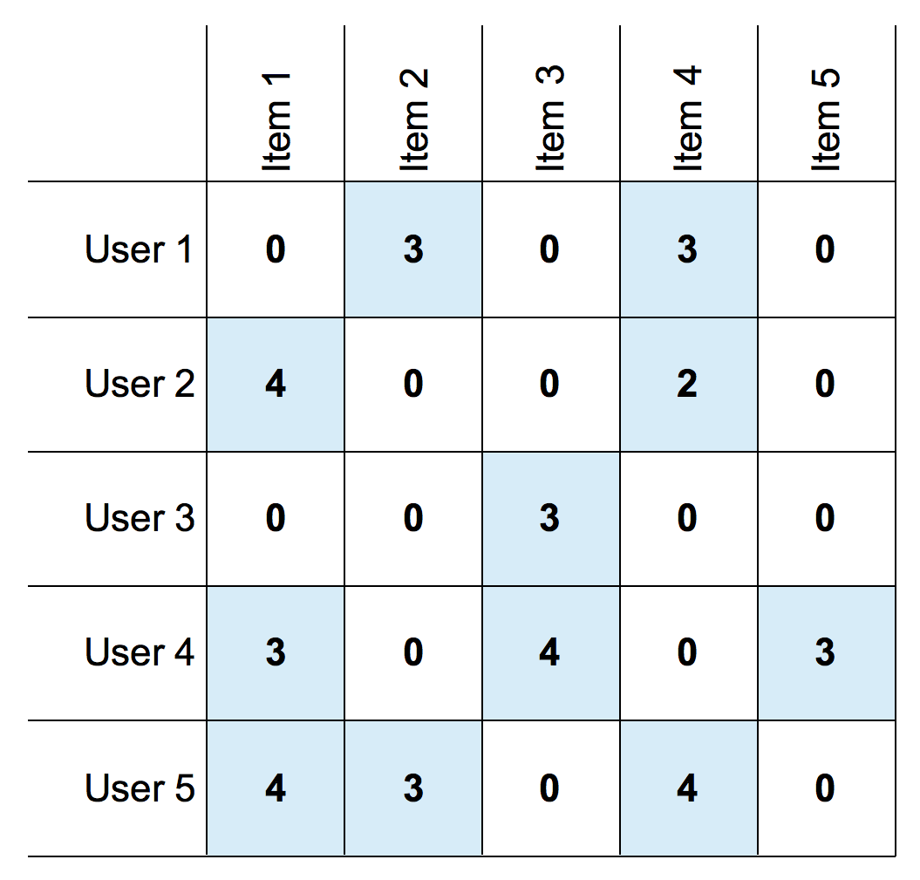
Utility Matrix

Slide 15
Quantifying the similarity
U1
U1
M1
High
High
Euclidean Distance
M2
M1
Low
M2
Low
Angular Distance
Low
High
U2
Low
High
U2
Dissimilar Users
Similar User
Option 1 : Cosine distance
Option 2 : Pearson Correlation

Slide 16
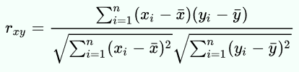
Pearson Correlation Similarity Measure
Let xi denote the rating given by user x to item i. If l is the set of all items that two users x and y have both rated, then the Pearson Correlation Similarity Measure between the two users is given by:
Where x̄ denotes the average rating given by user x to all items. To calculate x̄ we only consider items that rated by the user.

Slide 17
Recommendation
One way of predicting the value of the utility matrix entry (estimated rating) of a given user u for item i, is to average the ratings of top_n users.
Other approach is to first normalize the utility matrix.

Slide 18
Recommendation
That is, for each of the n most similar users, subtract their average rating for all items from the rating of the item of interest i. Take the average of these differences for those users who have rated i, then add this average difference to the average rating that u gives for all items.

Slide 19
Disadvantages
Cold Start: There needs to be enough other users already in the system to find a match.
Sparsiy: Most users do not rate most items and hence the user-item matrix is typically very sparse. It is hard to find users that have rated the same items.

Slide 20
Disadvantages
First Rater: It is not possible to recommend an item that has not been previously rated. This problem comes for new items mostly.
Popularity Bias: CF cannot recommend items to someone with unique tastes. In that case there is a tendency to recommend the popular.

Slide 21
Web Application Framework(Flask)
A lightweight microframework
Reusing existing code
Lots of documentation
Neat way to write small apps
Easy to interface with Python web applications frameworks
We have used Flask to create our web server.

Slide 22
Flask Structure
from flask import Flask
app = Flask(__name__)
@app.route('/')
def index():
return 'Hello world!'
if __name__=='__main__' :
app.run(debug=True)

Slide 23
Localhost Of Flask
$ python hello.py
*Running on http://127.0.0.1:5000/
*Restarting with reloader. . .

Slide 24
Rendering Templates
from flask import render_template
@app.route('/')
def index() :
return render_template('index.html',
variable='value'
)
Flask uses render_template to render HTML which will display in the user's browser.

Slide 25
The Request Data
from flask import request, flash, redirect, \
url_for, request
@app.route('/new', methods=[' GET ' , 'POST '])
def new() :
if request.method == ' POST ' :
request.form['Movie_name']
request.form['rating']
return render_template('index.html')
Flask uses request to access the request data easily.

Slide 26
Demo Of Recommendation

Slide 27
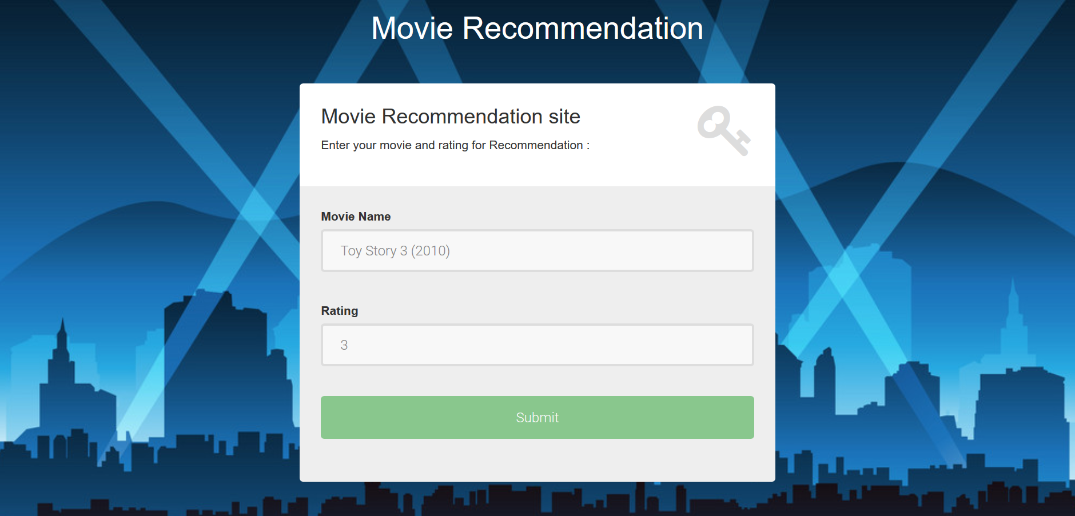
Input Page

Slide 28
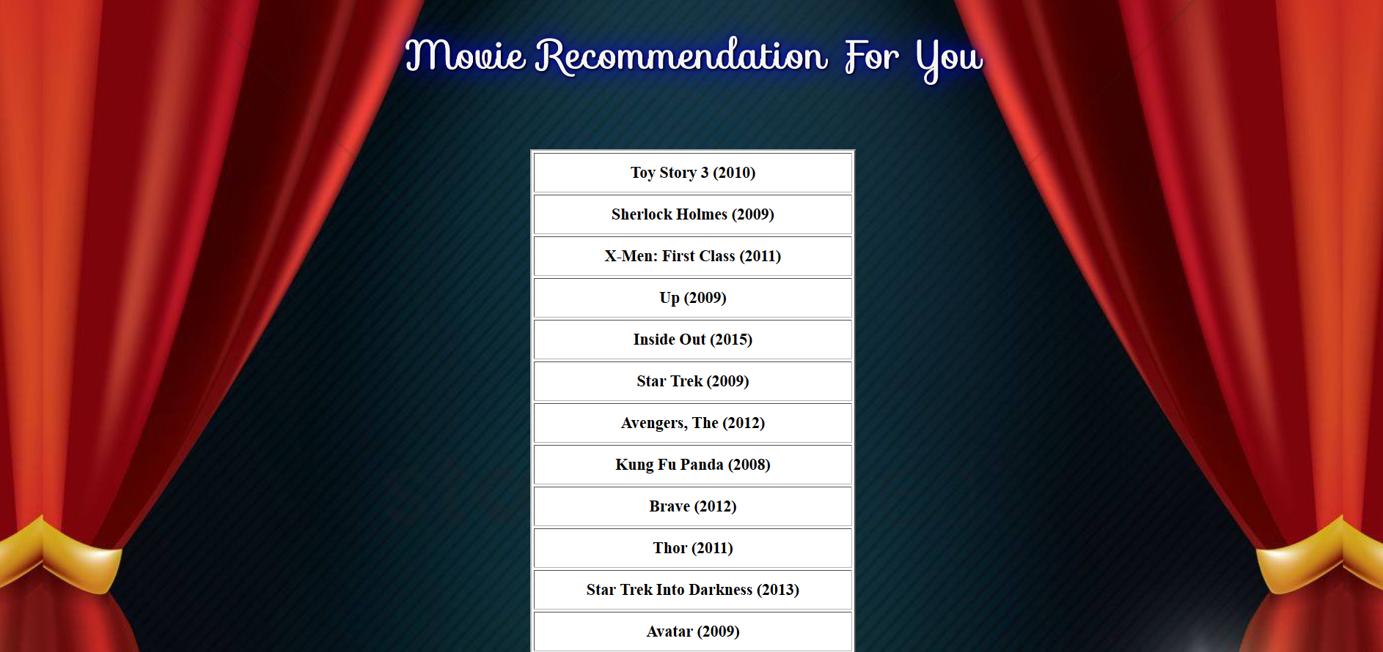
Output Page

Slide 29
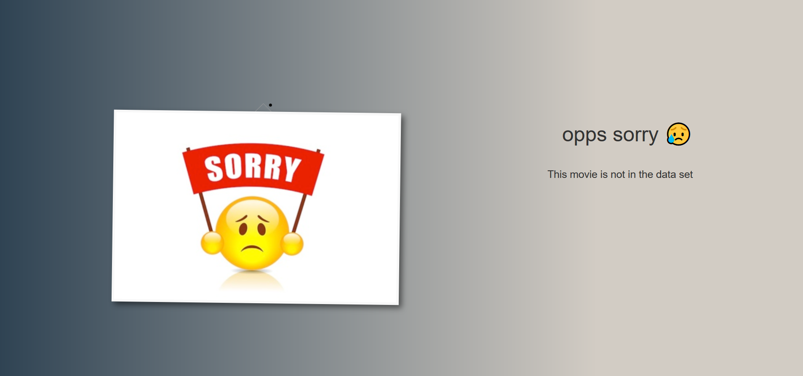
Error Page

Slide 30
Thank You

